Slide 1
Data Description
Date ==> The Date ranges between 2017-2018
Rented Bike Count ==> The number of rented bikes (Class Label)
Hour ==> day time [0-24]
Temperature(°C) ==> Temperature Degree in Celsius
Humidity(%) ==> Parentage of humidity
Wind speed (m/s) ==> Wind speed (The values approximately ranges between [0-5])
Visibility (10m) ==> means that a person should be able to see and identify in the daytime (value 2000 means the Visibility of the day is clear. The Visibility decrease by decreasing the this value)
Dew point temperature(°C) ==> The dew point is the temperature the air needs to be cooled to
Solar Radiation (MJ/m2) ==> electromagnetic radiation emitted by the sun
Rainfall(mm) ==> Rainfall
Snowfall (cm) ==> Snowfall
Seasons ==> (Winter, Summer, Spring) Autumn season is missing should be add it in the data
Holiday ==> If the day is public vacation or not
Functioning Day ==> Neither the day is working day of weekend

Slide 2
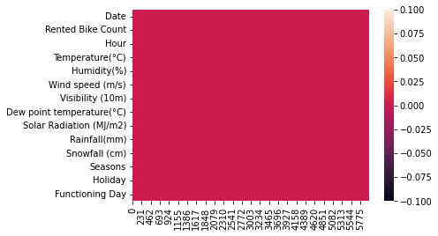
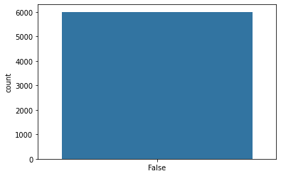
Check The Null Values and Duplicates
There Are No Null Values
There Are No Duplicated Values

Slide 3
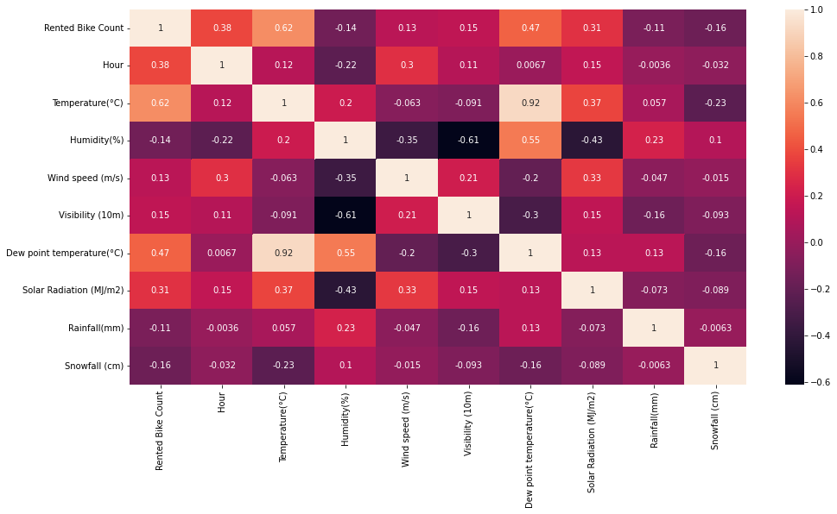
Check The Correlation between Variables
Notes:
Correlation Matrix Explanation
There is a strong correlation between Temperature and De point Temperature and Solar Radiation as we would expected
The rented Bike count is directly affected with Hour. I think the people would rent a bike in the time that before and after the work
The rented Bike count have strong correlation with Temperature and Dew Point Temperature and Solar Radiation. When The Day is sunny, the emission of electro magnetic waves increase so the probability of people to rent a bike increase as they need cooling there bodies.
Rented Bike Count have inverse Correlation with Rainfall and Snowfall, this is a week correlation but it is make sense when the day is rainy or have snowfall the people would prefer to stay at home
The Temperature have weak correlation with Windspeed. Sometimes when the day is windy the temperature decrease so it make sense
Humidity have strong inverse correlation with Visibility as we would expected, When the humidity increase the visibility become harder
humidity is inversely related to Rented Bike Count as expected as the people won't rent a bike in humid days and also the visibility in these days is harder

Slide 4
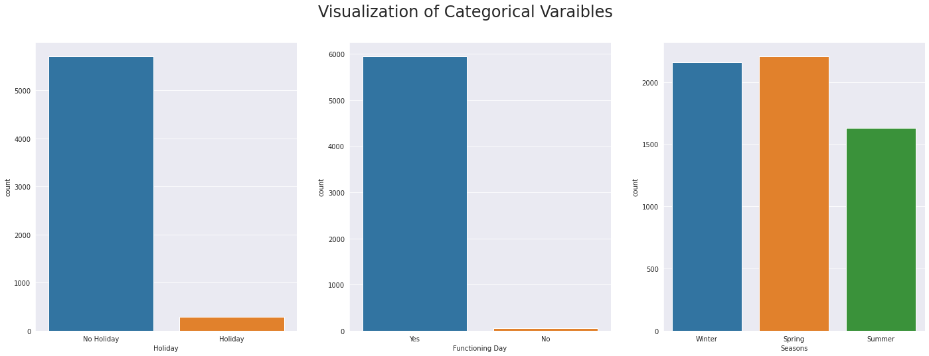
as we see in Holiday, the majority of Holiday is on non holiday days.
in Functioning day column, the majority Functioning day is on Functional Day.
Autumn season is missing
This data is unrealistic specially Functioning day as We at least have non functioning day at the holidays and both Friday and Saturday and also the count of non functioning day is less than the count of holidays so it does not make sense

Slide 5
Preprocessing Steps
Add Date feature (Year – month – day of week – week of year)
Apply label encoder on Year column
Handel missing seasons
Drop Date Column
Rest Functioning day and Holiday
Add Fog Column[‘Yes’, ‘No’]
Add Shift/Lag for time series prediction
Make One Hot Encoder for (Seasons, Holiday, Functioning Day). Make drop first to avoid dummy trap
Notes:
Fog is a relation between temperature and Dew point temperature. The smaller the difference between temperature and dew point temperature the higher relative humidity and more water condenses then fog happens

Slide 6
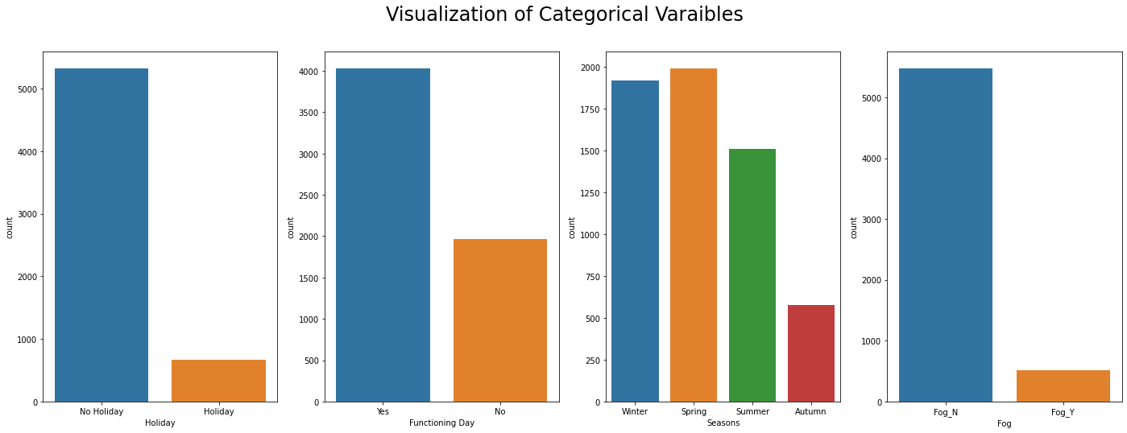
Now Holiday and Functioning day make sense
Missing seasons are resolved
The smaller the difference between the temperature and the dew point temperature, the higher the relative humidity (the closer the atmosphere is to a state in which water vapor would condense).

Slide 7
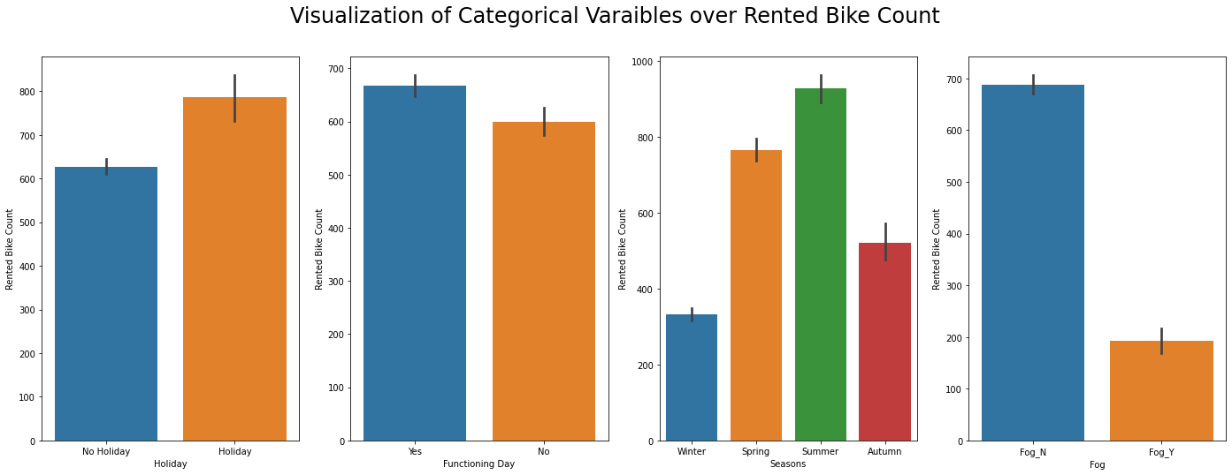
The Demand on Rented Bike Count is high on Holidays as we would expected
The Demand on Rented Bike Count is high on Functioning days but it is also make sense as the people could rent a bike before or after the work
The demand on Rented Bike Count increases in Spring and Summer then starts to decreases in autumn and winter
The Demand increases in the days where are no Fog

Slide 8
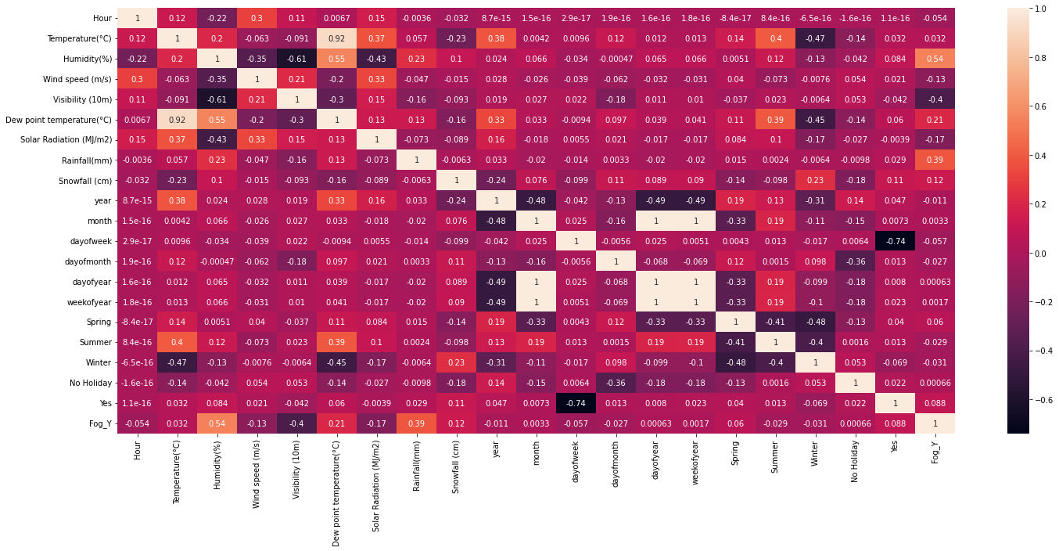
Visualizing Correlation After Preprocessing (Without Lag Features)
Notes:
If it is a foggy day the demand on renting bike decrease as there is a weak correlation
The Humidity, Rainfall increases in foggy days while the Visibility decreases so in order of that the demands on rented bike in theses days decreases

Slide 9
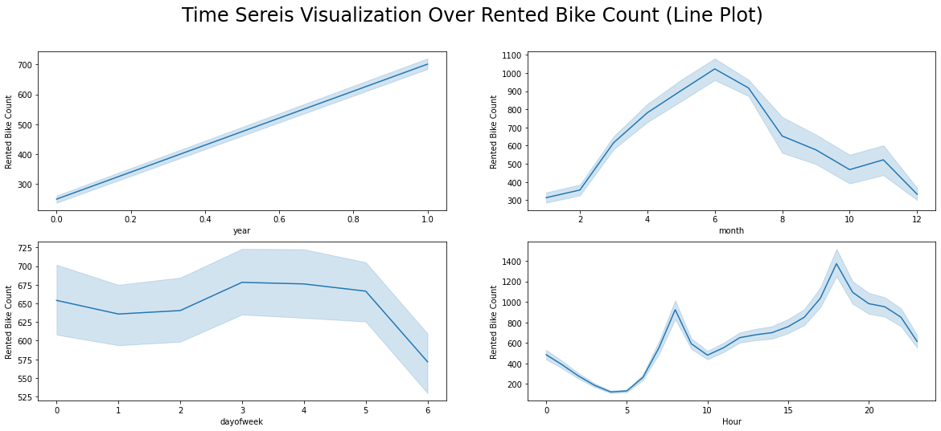

Slide 10
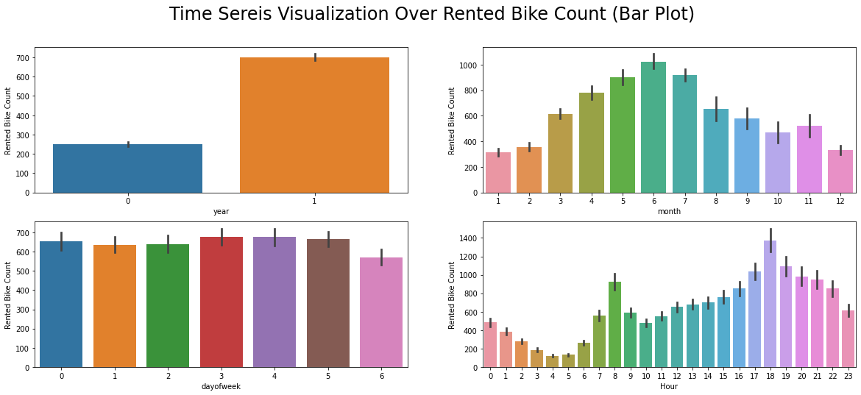
The Demand of the renting bikes is increased from 7-9 AM Before the people going to the work, then increased again from 5-9 PM as people finish there work and return to home.
The demand on renting bike has increased over the years.
The demand on renting bikes starts to increase at the beginning of week then slightly decreases at the weekend
The demand on renting bikes over Seasons
The demands starts to increase in Summer
The demands reach its peek at the beginning of Spring
The demands starts to decrease in Autumn and Winter

Slide 11
Feature Scaling/Transformation
Some models need feature scaling like (Ridge, SVR)
RandomForest, XGBoost, CatBoost and AdaBoost does not required feature scaling as Tree-Based Algorithms are not affected by feature scaling.

Slide 12

Regression Techniques
Split The Dataset into in train and test with ratio 0.8 training and 0.2 testing
Random Forest Regression
Support Vector Regression
Ridge Linear Regression
AdaBoost
XGBoost
CatBoost

Slide 13
Regression Technique Results
Regression Model | Random Forest | Support Vector Regression | Ridge Regression | AdaBoost | XGBoost | CatBoost
Test Error | 211.4505 | 611.3853 | 456.8123 | 359.6021 | 201.2133 | 172.6621

Slide 14
Hyper parameters Tuning
Apply
Grid Search on Random Forest to find the optimal parameters which are ({'max_depth': 16, 'n_estimators': 200}).
RMSE = 211.4504
Apply
Grid Search on XGBoost (learning_rate=0.2, random_state = 42)
RMSE = 201.2133
Apply
Grid Search on CatBoost (learning_rate=0.175, random_state = 42)
RMSE = 172.6621

Slide 15
Post Preprocessing
The predicted Rented Bike Count is float, We take the integer number
Some models predict negative values like (XGBoost and CatBoost), We make it equal to zero

